Slide 1

Fake Logo Detection System
Jayamukhi Institute of Technological Sciences, Narsampet.
Presented By :
Saishivani Kandarapu 20C41A0535
Primrose Naliganti 20C41A0510
Sai Deeraj Eastem 20C41A0560
Guide :
Mrs. N. Sindhuja (Assistant Professor)

Slide 2
Abstract
Every year, top brands lose a significant percentage of their sales to unauthorized brands which are using their same logo but in a slightly different way. Moreover such products are usually of an low quality, they also end up damaging the credibility of the brand. Many times buyers get cheated out of their earned money as they end up buying the fake products. The old system provides the way to find only the brand logo so the system is not so useful to prevent people from buying forged projects. The existing system can find only the logo but can't find whether its real or fake. Since the differences is more minute people can’t identify it easily. This Logo Detection System aims to help consumers distinguish fake from the original product. Using this system, a consumer can verify whether a product real or forged. This System can also be helpful for brands struggling to fight against forged products and it allows the users to complain the original brand about the fraudulent activities, so that the brand owners can take sufficient action to reduce the fraudulent activities and prevent the people from buying the fake products and also they can prevent themselves from damaging their credibility.

Slide 3

Contents
Introduction
SSIM
Existing System and Proposed system
Modules
Datasets
Block diagram of Proposed system
System Requirements
Conclusion
Technologies used
Reference

Slide 4
Introduction
In the era of digital commerce and social media, logos pose a significant threat to brand integrity and consumer confidence.
To tackle this challenge, a Fake Logo Detection System utilizing Python emerges as a crucial tool which uses Django, HTML, CSS, JavaScript. The primary method utilized for comparison is Structural Similarity (SSIM), a powerful technique for measuring the similarity between images.
With the growth of digital platforms, distinguishing between real and fake logos has become increasingly challenging. Fake Logo Detector simplifies this process by allowing users to upload suspicious logo images.
Fake Logo Detector empowers users to make informed decisions about the logos they encounter online, contributing to the protection of brand integrity and consumer trust in the digital landscape.

Slide 5
SSIM (Structural Similarity Index Measure)
SSIM is a metric used to quantify the similarity between two images.
SSIM takes into account three key components of perceived image quality: luminance, contrast, and structure.
By comparing these components, SSIM provides a value between -1 and 1, where a value closer to 1 indicates higher similarity between the images.
This metric is commonly used in image processing tasks such as image compression, image restoration, and image quality assessment.
In the context of the Fake Logo Detection System, SSIM is utilized to compare uploaded logo images with a dataset of authentic logos, helping to determine the authenticity of the logos in question.

Slide 6




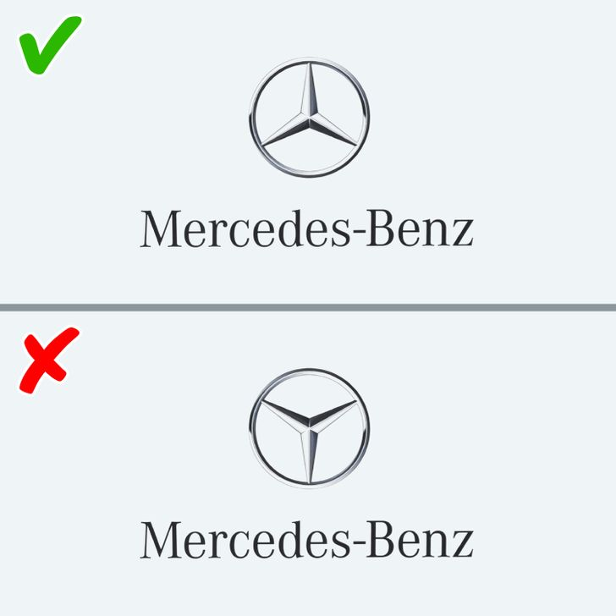

Slide 7
Existing System
The existing system provides the way to find only the brand logo so the system is not so useful to prevent people from buying forged projects.
The existing system can find only the logo but can't find whether it's real or fake. Since the differences is more minute people can’t identify it easily.
In The Existing system the logo name is displayed with the grid like structure around the logo and not much thing to find the fake one, the old systems that didn’t used the yolo very much struggled to find the logo in the real time environment.
Since the old systems scanning speed is less and it doesn’t have the ability to find the small logo images.

Slide 8
Proposed System
The proposed fake Logo Detection System aims to help consumers distinguish fake from the original product. Using this system, a consumer can verify whether a product real or forged. This System can also be helpful for brands struggling to fight against forged products.
This system allows the users to complain the original brand about the fraudulent activities, so that the brand owners can take sufficient action to reduce the fraudulent activities and prevent the people from buying the fake products and also they can prevent themselves from damaging their credibility.

Slide 9
Modules
Training Module
A custom dataset is created using sample images, augmented via data augmentation methods to expand the dataset.
The dataset comprises two classes: Positives (original brand logos) and Negatives (fake brand logos).
Multiple images are collected for each brand in both grayscale and RGB formats. Training techniques are varied, and factors like epoch time and batch grouping significantly impact training efficiency.
These processes optimize the dataset training for accurate results.

Slide 10

Detection Module
After the completion of the training module the detection takes place.In this module the main aim is to detect the region of the logo.
Once the training is completed the model file is generated which is primarily used to compare the logo detected in realtime with the logo in the dataset.
These were the processes that takes place in the detection module of the fake logo identification system.

Slide 11
Output Module
This is the final phase in which the the output is shown to the user after analyzing all the factors.
The output is shown in a bounding box labelled as "Real logo" And "Fake Logo detected".
So in this phase the output user got will be useful for him to buy the original product and prevent themselves from buying it. The system differentiate the original and fake ones by comparing with the elements in the dataset.

Slide 12
Datasets
Original logo to define the brand recognition
Input logo/image to detect whether the logo is fake or not.

Slide 13
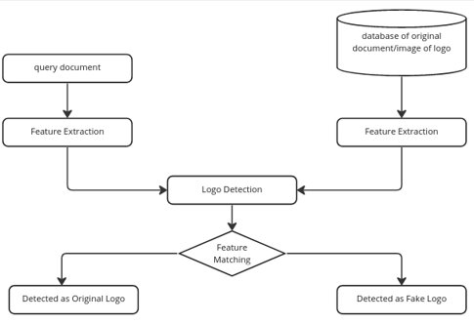
Block diagram of Proposed System

Slide 14
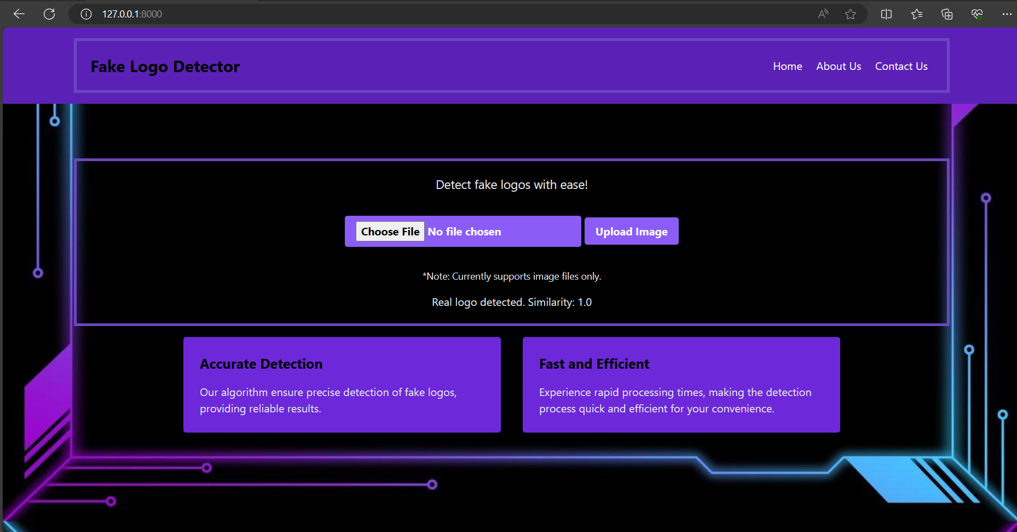

Slide 15
System Requirements
Windows 7 or higher
XAMPP Server
Python
Text Editor (Notepad++ )

Slide 16
Conclusion
In summary, the Fake Logo Detection System using Python offers an effective solution to combat fake logos online.
Leveraging machine learning and Python programming, it accurately identifies fake logos through structural similarity comparisons. This system enhances brand integrity, consumer trust, and intellectual property protection.
Overall, the Fake Logo Detection System using Python represents a promising approach to combating fake logos and promoting a safer, more trustworthy online environment for businesses and consumers alike.

Slide 17
Technologies used
Frontend
HTML
CSS
JavaScript
Backend
Python using Django framework

Slide 18
Reference
https://en.wikipedia.org/wiki/Object_detection
https://ieeexplore.ieee.org/document/9440236
https://www.mifratech.com/public/blogpag/Online+Fake+Logo+Detection+System
https://www.ijser.org/researchpaper/Finding-Fake-Logo-Using-CDS-LogoDetection-And-Recognition-Algorithm.pdf
https://ieeexplore.ieee.org/document/9391842

Slide 19


